Slide 1
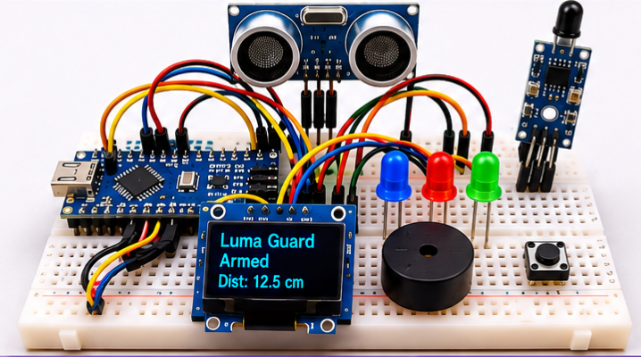
MINI PROJECT
Luma Guard
A Smart Safety System for Flame
Detection and Distance Monitoring
Presented By:
RONALD REX C H - 111924EC01135
RAHUL P - 111924EC01125
RUDRA KUMAR M - 111924EC01136
III ECE A
S.A. Engineering College

Slide 2

01 / THE NEED
A sensor trigger alone is not a complete safety response
A BASIC SENSOR-TO-OUTPUT PATH
WHAT THE PROJECT ADDRESSES
01
Brief transients
01
Raw sensor signal
A short-lived sensor change should be checked before it becomes a confirmed condition.
A changing input is read.
↓
02
Threshold chatter
02
Single threshold
Separate trigger and clear boundaries help avoid rapid switching near a limit.
A direct comparison decides.
↓
03
Unclear operating state
03
Buzzer output
The operator needs to distinguish a candidate, a confirmed alert, a silenced alert and an unknown reading.
An immediate alert is generated.
The challenge is not only detecting a change; it is interpreting it consistently.
DESIGN GOAL
Make detection decisions deliberate and system status easy to interpret.
Notes:
2

Slide 3
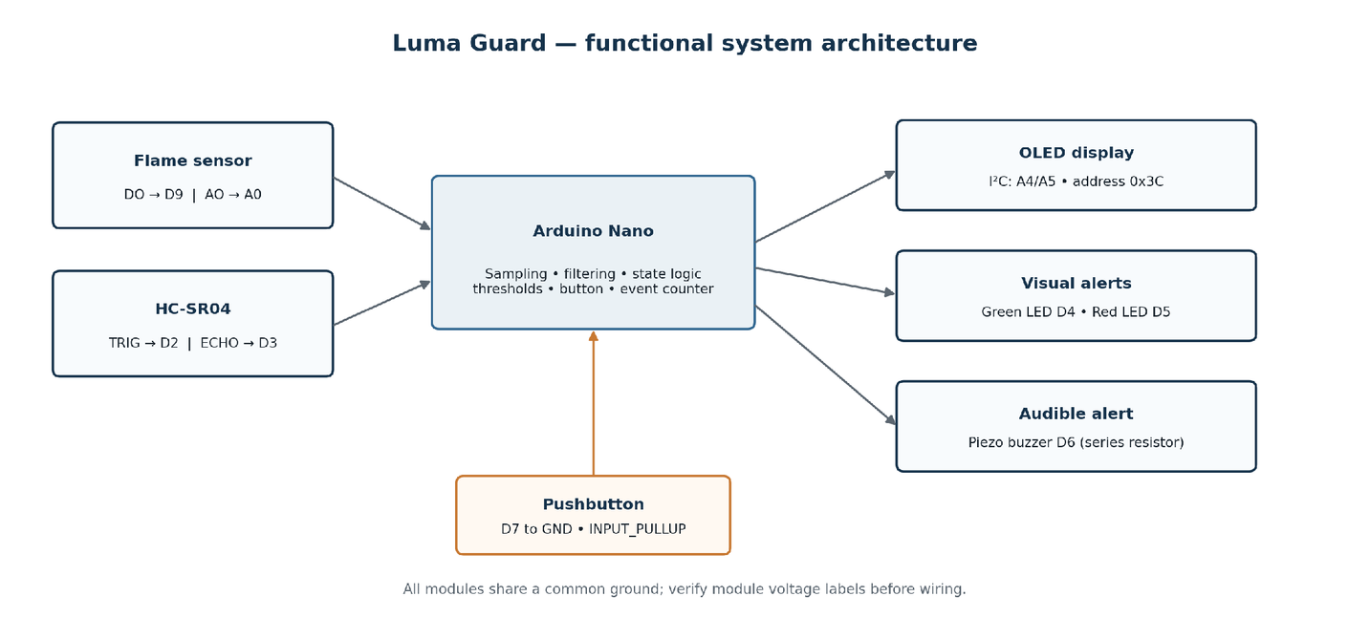
02 / THE PROPOSED SYSTEM
Two sensing channels, one local monitoring unit
THREE PARTS OF THE SYSTEM
FLAME RESPONSE
Flame module • DO + AO
Checks for a sustained flame-like optical response.
WORK-ZONE DISTANCE
HC-SR04 ultrasonic echo
Checks distance to a reflecting object against the configured zone boundary.
OPERATOR INTERFACE
OLED • LEDs • buzzer • button
Shows interpreted status and gives local audible / visual feedback.
Notes:
3

Slide 4
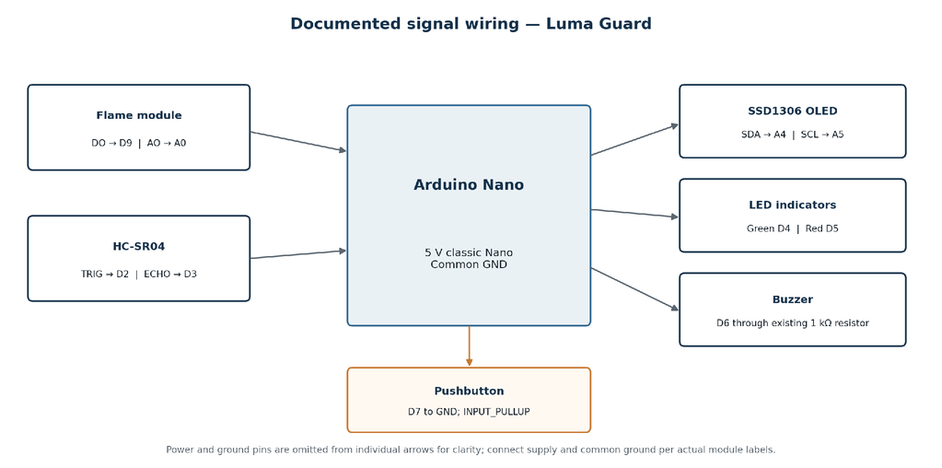
03 / SYSTEM ARCHITECTURE
DOCUMENTED PIN ASSIGNMENT
DEVICE
SIGNAL
NANO PIN
Flame module
DO / AO
D9 / A0
HC-SR04
TRIG / ECHO
D2 / D3
SSD1306 OLED
SDA / SCL (0x3C)
A4 / A5
Green LED
Anode via resistor
D4
Red LED
Anode via resistor
D5
Piezo buzzer
Existing 1 kΩ series resistor
D6
Pushbutton
To GND; INPUT_PULLUP
D7
Notes:
4

Slide 5
04 / OPERATING LOGIC
The firmware confirms, signals and recovers
01 / SAMPLE
02 / CONFIRM
03 / ALERT
04 / RECOVER
Read the inputs
Apply boundaries
Drive the outputs
Clear deliberately
Sensor checks run on a 100 ms schedule. Flame DO/AO and HC-SR04 distance are evaluated separately.
›
Flame: DO LOW or AO ≤ 800; confirm after 250 ms. Zone: filtered distance ≤ 30 cm.
›
Hazard flags control the OLED, LEDs and pulsed buzzer. A 2,400 Hz tone is on for 80 ms per pulse.
›
Flame clears after DO HIGH and AO ≥ 850 for 1,200 ms. Zone clears above 33 cm for 350 ms.
ONE BUTTON, TWO ACTIONS
LOCAL STATUS AND DIAGNOSTICS
SHORT PRESS
Acknowledges the active alarm; monitoring continues.
OLED refresh
250 ms
Serial Monitor
500 ms
HOLD 2 s
Toggles the system between ARMED and DISARMED.
A stale distance is shown as NO ECHO / ZONE UNKNOWN after 800 ms without a valid reading.
Notes:
5

Slide 6
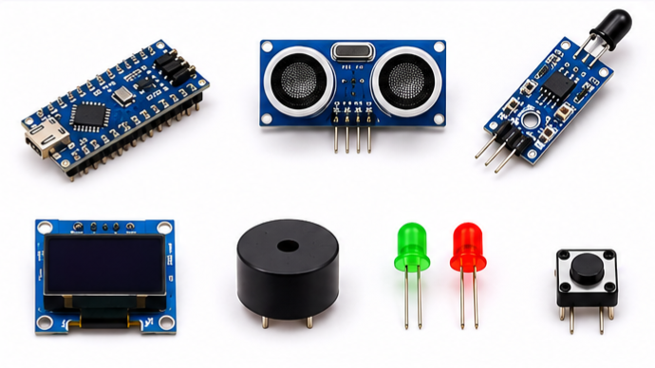
05 / HARDWARE AND SOFTWARE
HARDWARE USED
Arduino Nano
Flame sensor
SOFTWARE ELEMENTS
ATmega328P controller
Optical module; DO and AO
Arduino IDE
Edit, compile and upload the sketch
HC-SR04
SSD1306 OLED
Wire
Ultrasonic echo distance
128 × 64 local status display
I²C communication with the OLED
Adafruit SSD1306 + GFX
Green + Red LEDs
Buzzer + one button
Visual operating / alert cues
Audible alert and operator control
OLED initialization and graphics
EEPROM
Retains the hazard-start counter
Serial Monitor
Diagnostics at 9,600 baud
Notes:
6

Slide 7
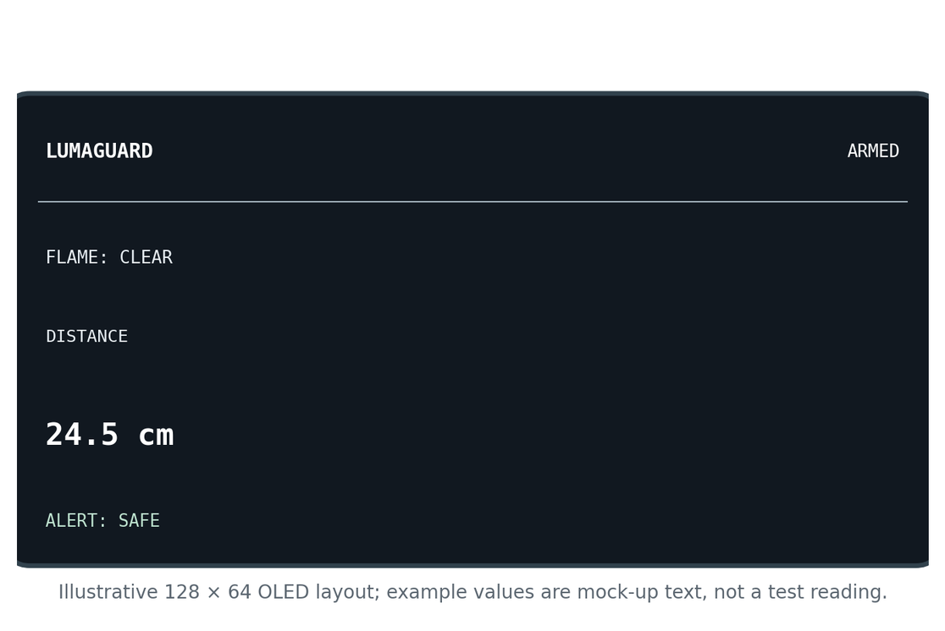
06 / OPERATOR INTERFACE
The OLED keeps the system state visible
WHAT THE SCREEN REPORTS
MODE
ARMED / DISARMED
FLAME
CLEAR / CHECK / DETECTED
DISTANCE
Filtered distance in cm / NO ECHO
ALERT
SAFE / ZONE / FLAME / SILENCED
PHYSICAL OUTPUTS
GREEN LED
Armed, clear and fresh distance data.
RED LED
Unacknowledged active alert.
BUZZER
Pulsed at 2,400 Hz; 80 ms ON time.
Notes:
7

Slide 8
07 / CONCLUSION
WHAT THE PROJECT DEMONSTRATES
LIMITATIONS TO KEEP IN VIEW
01
Separate optical flame-response and ultrasonic zone flags.
Flame-module response varies with ambient IR, orientation and comparator setting.
HC-SR04 depends on a usable echo path; it does not identify the reflecting object.
02
Persistence and hysteresis before key state transitions.
pulseIn() can block the loop for up to 25,000 µs; EEPROM stores a count, not an event history.
03
OLED, LED and buzzer feedback with one-button acknowledgement / ARM-DISARM control.
The prototype is not certified fire-detection equipment; quantitative performance metrics were not established.
04
EEPROM retention of a hazard start count across power cycles.
NEXT STEPS
Repeatable instrumented trials • threshold characterization • asynchronous echo acquisition • richer event records
Thank You
Notes:
9

